Slide 1
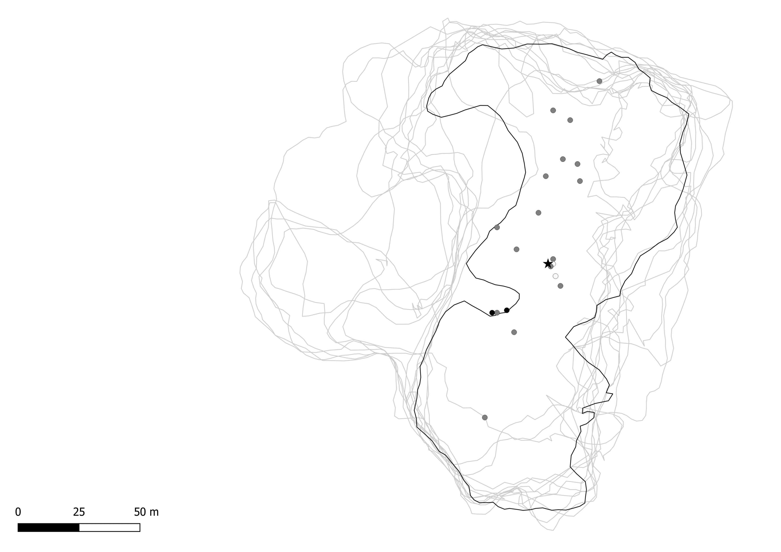

Redcliffe
Male composition
0% Male
Mixed
100% Male
Roost perimeter
August 2018
September 2018
October 2018
November 2018
December 2018
January 2019
February 2019
March 2019
April 2019
May 2019
June 2019
July 2019
August 2019
Notes:
Dots show proportion of tree count that was male. White =0% (all female); Grey = 0.1-99.9% (mixed); Black = 100% (all male). Star is roost center for that month

Slide 2
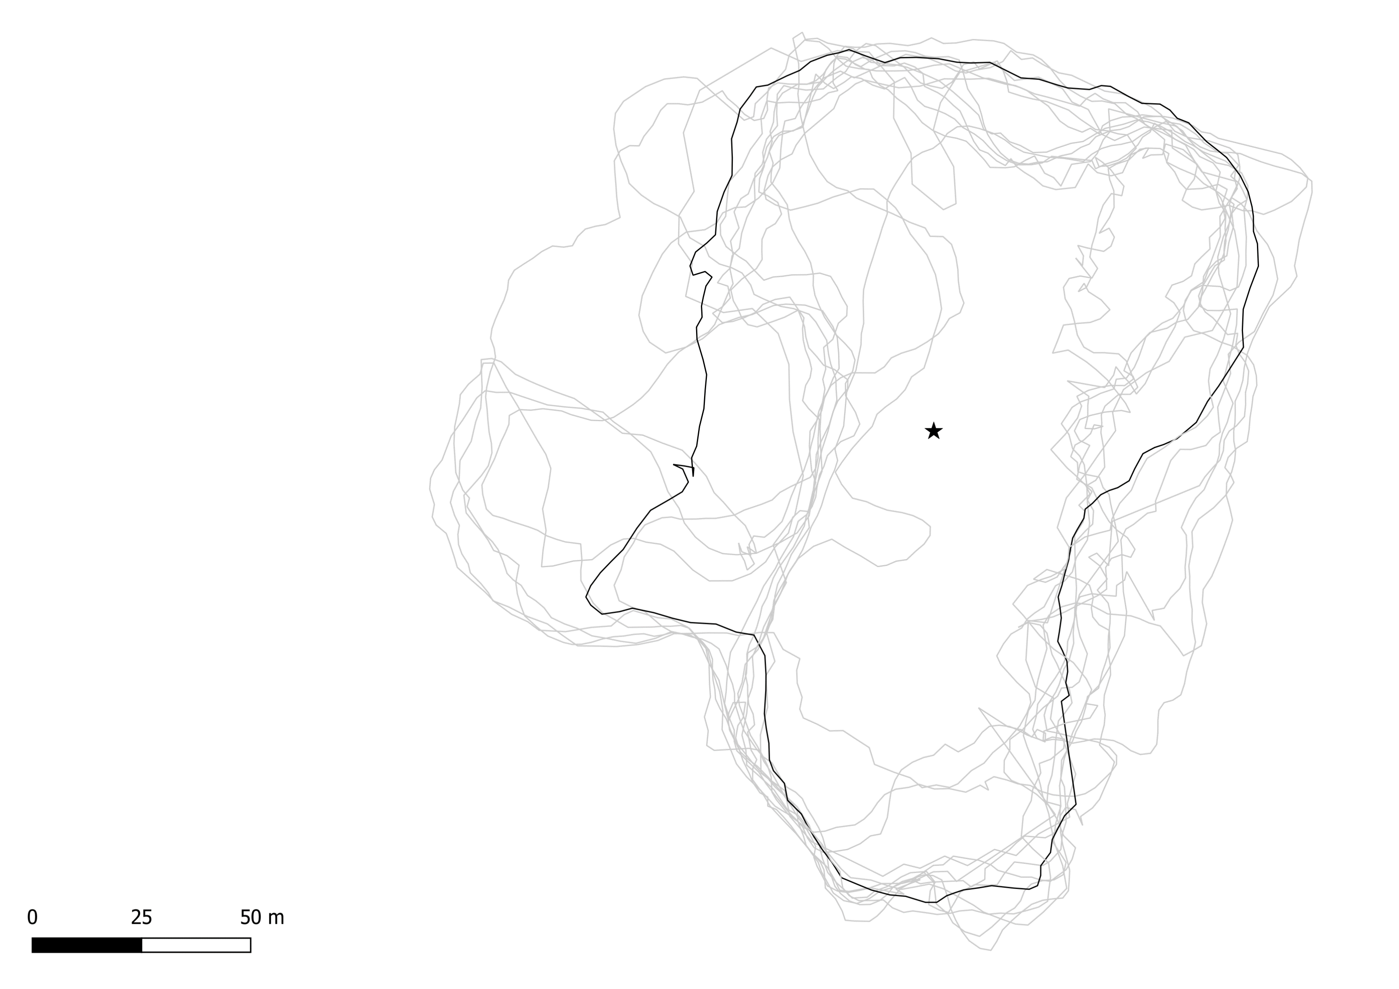
Redcliffe
Male composition
0% Male
Mixed
100% Male
Roost perimeter
August 2018
September 2018
October 2018
November 2018
December 2018
January 2019
February 2019
March 2019
April 2019
May 2019
June 2019
July 2019
August 2019

Slide 3
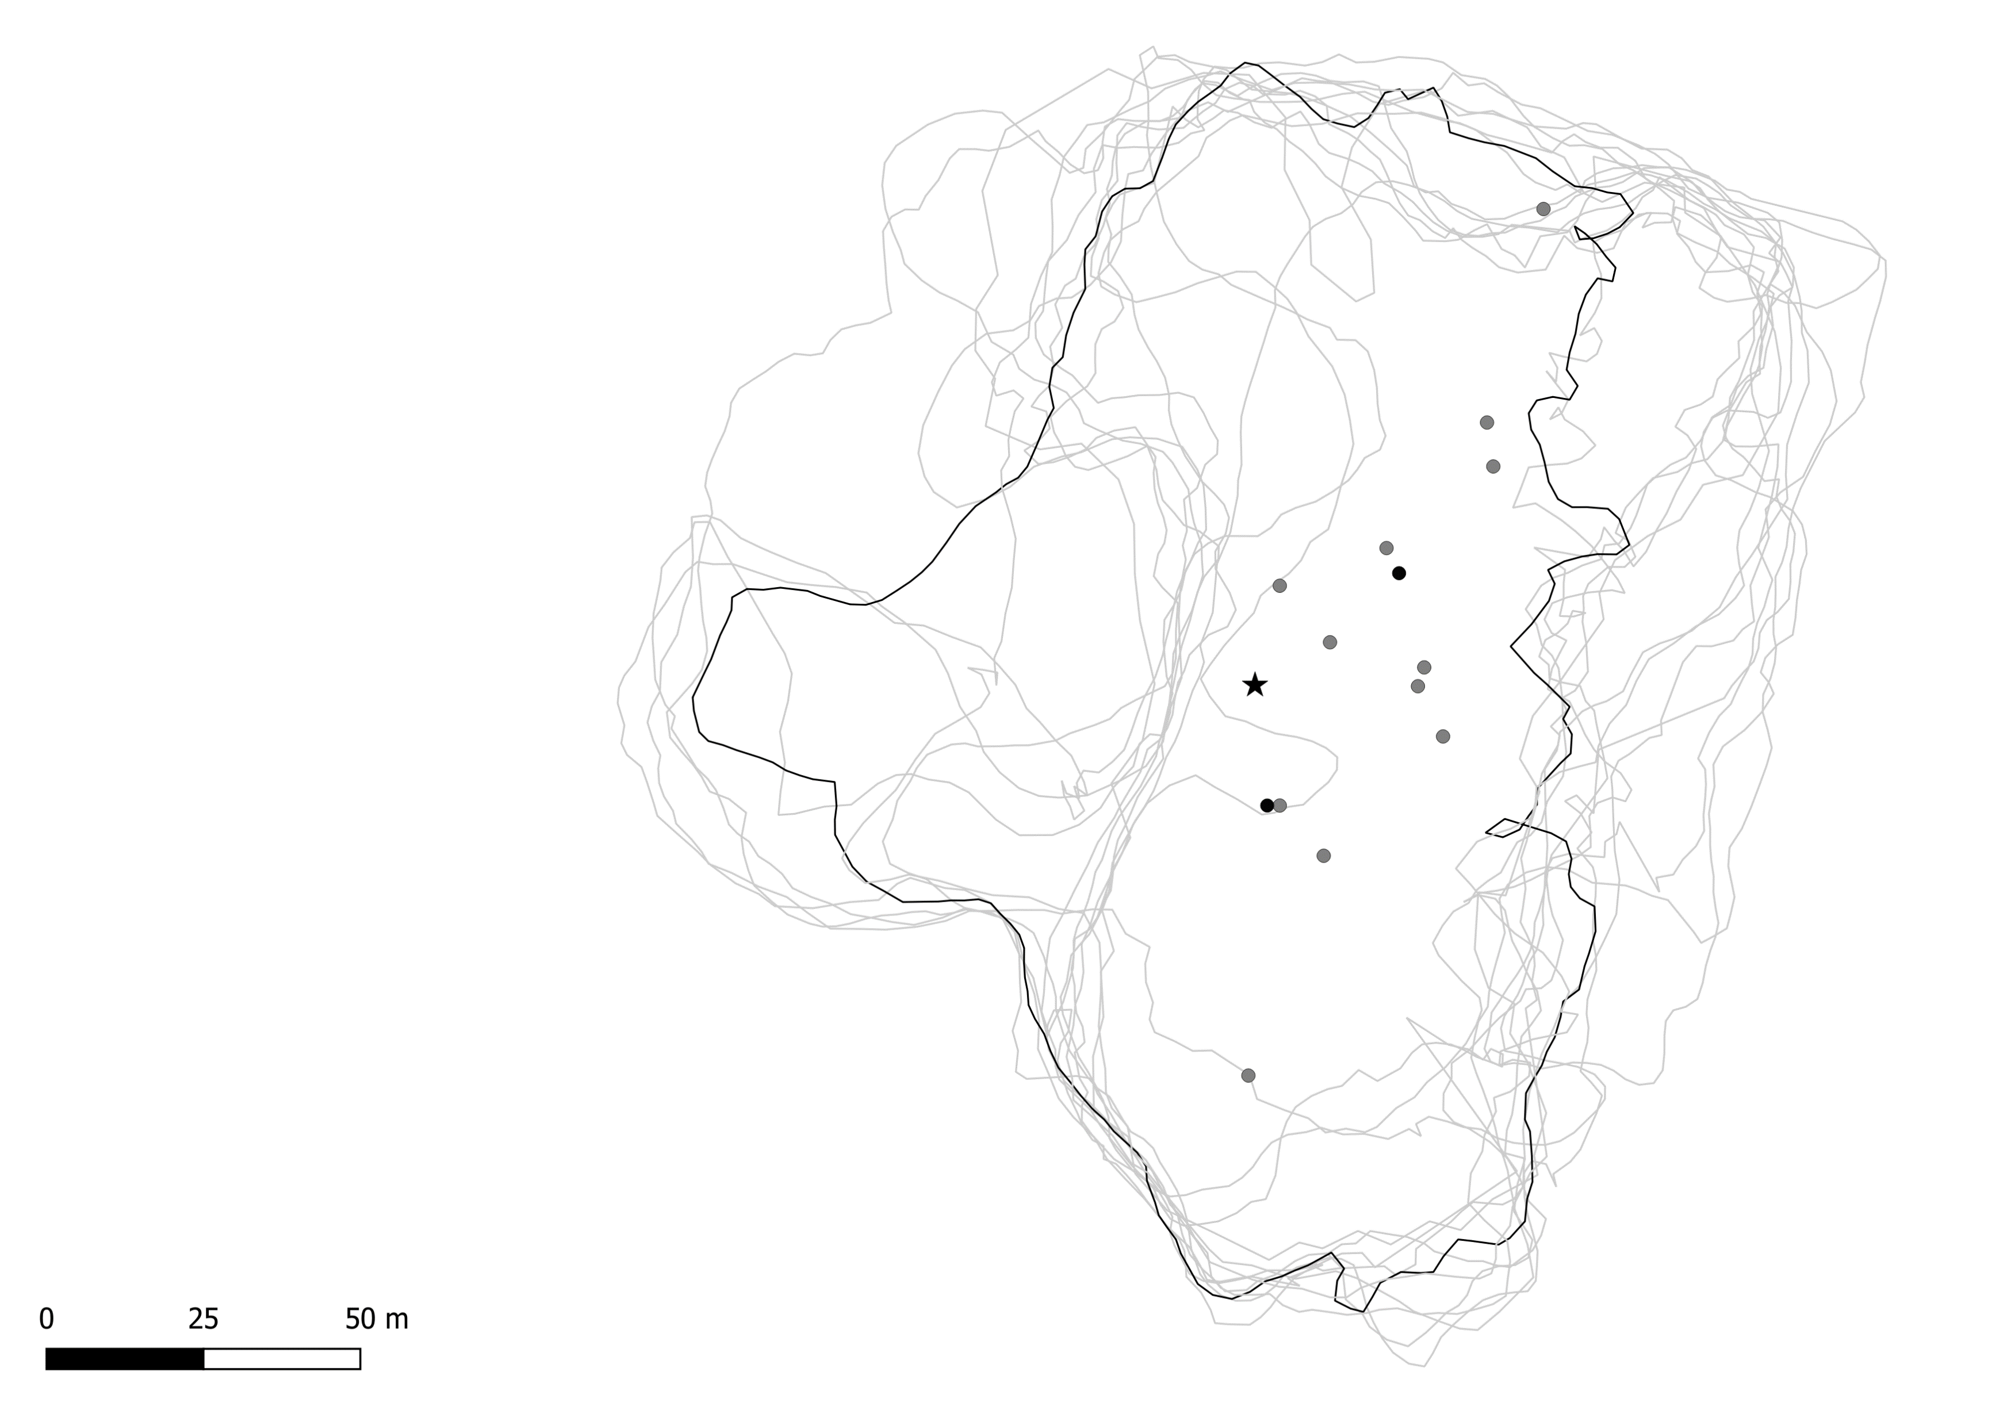
Redcliffe
Male composition
0% Male
Mixed
100% Male
Roost perimeter
August 2018
September 2018
October 2018
November 2018
December 2018
January 2019
February 2019
March 2019
April 2019
May 2019
June 2019
July 2019
August 2019

Slide 4
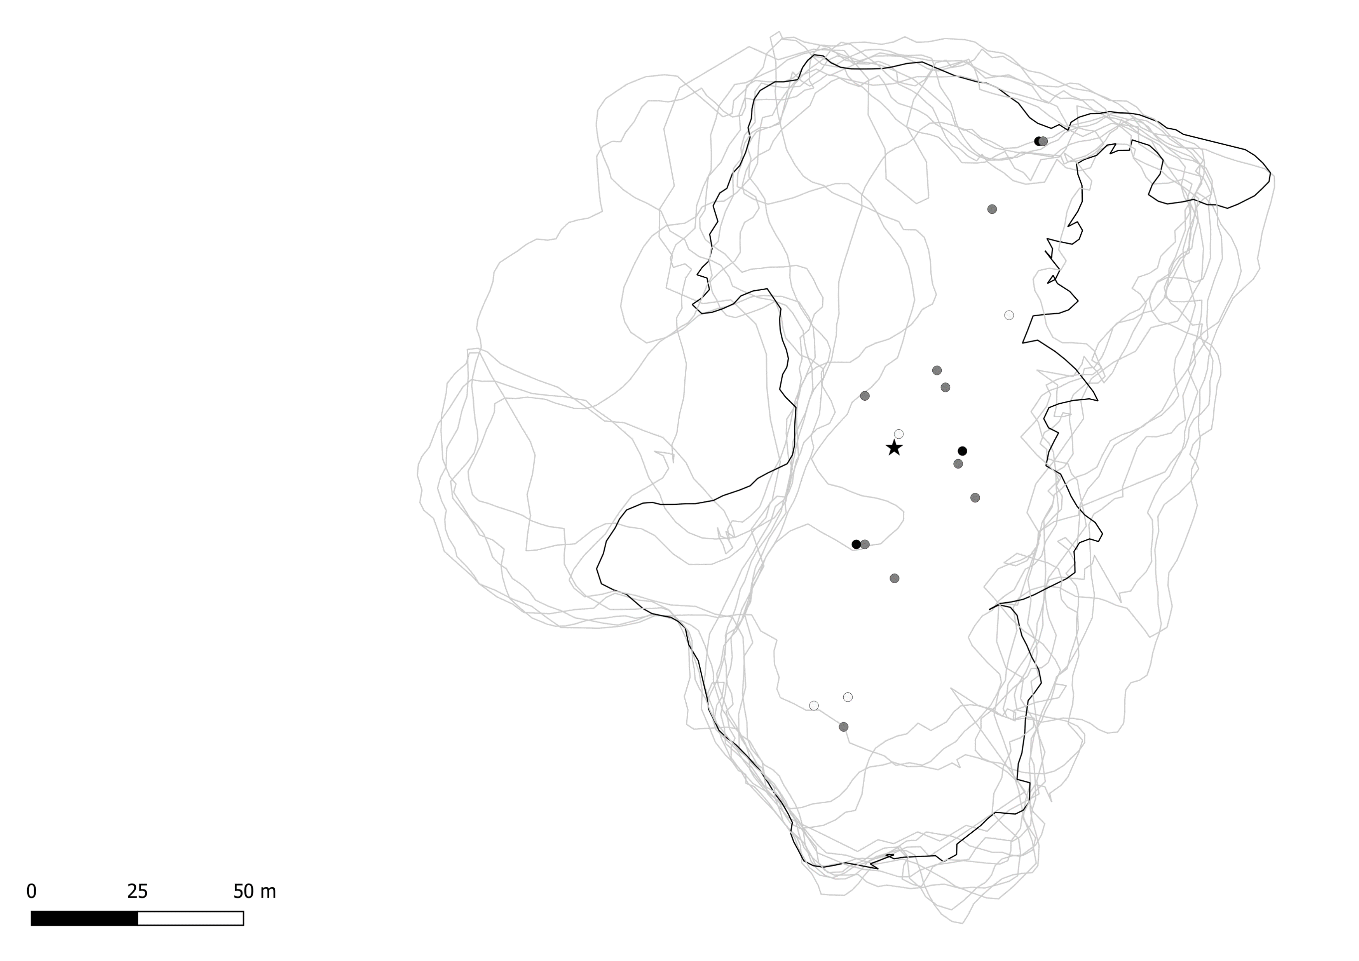
Redcliffe
Male composition
0% Male
Mixed
100% Male
Roost perimeter
August 2018
September 2018
October 2018
November 2018
December 2018
January 2019
February 2019
March 2019
April 2019
May 2019
June 2019
July 2019
August 2019

Slide 5
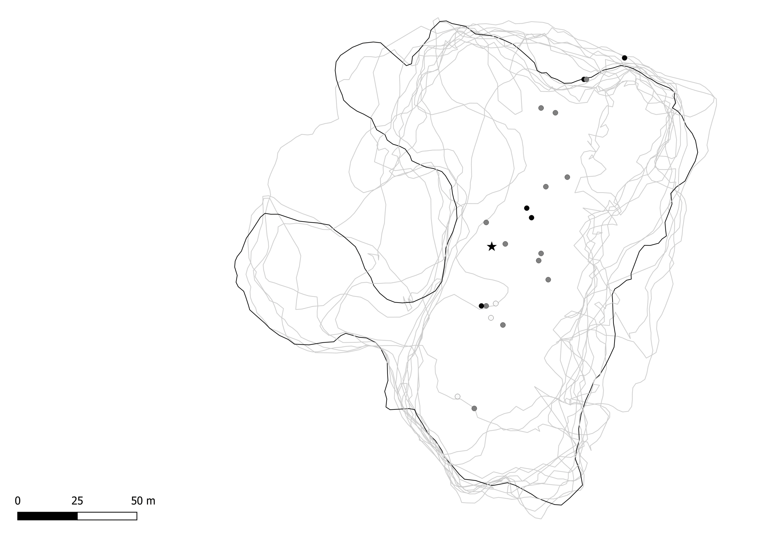
Redcliffe
Male composition
0% Male
Mixed
100% Male
Roost perimeter
August 2018
September 2018
October 2018
November 2018
December 2018
January 2019
February 2019
March 2019
April 2019
May 2019
June 2019
July 2019
August 2019

Slide 6
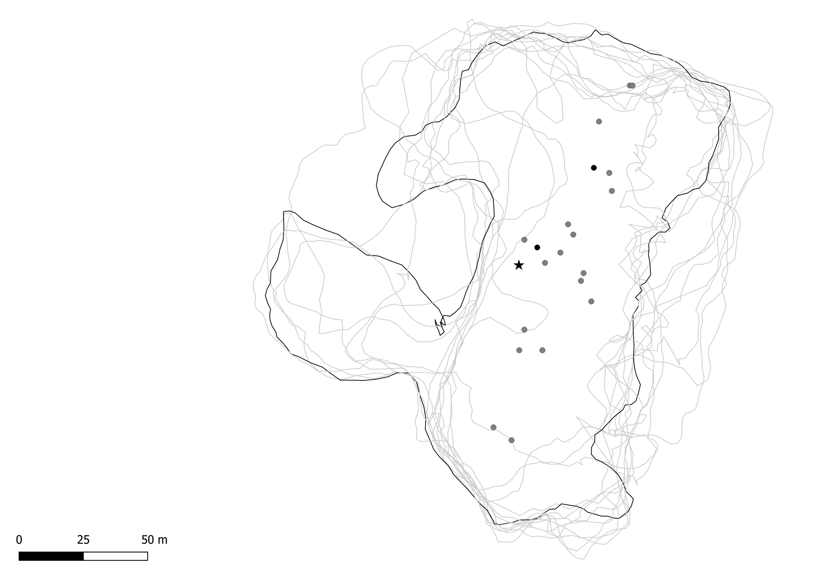
Redcliffe
Male composition
0% Male
Mixed
100% Male
Roost perimeter
August 2018
September 2018
October 2018
November 2018
December 2018
January 2019
February 2019
March 2019
April 2019
May 2019
June 2019
July 2019
August 2019

Slide 7

Redcliffe
Male composition
0% Male
Mixed
100% Male
Roost perimeter
August 2018
September 2018
October 2018
November 2018
December 2018
January 2019
February 2019
March 2019
April 2019
May 2019
June 2019
July 2019
August 2019

Slide 8
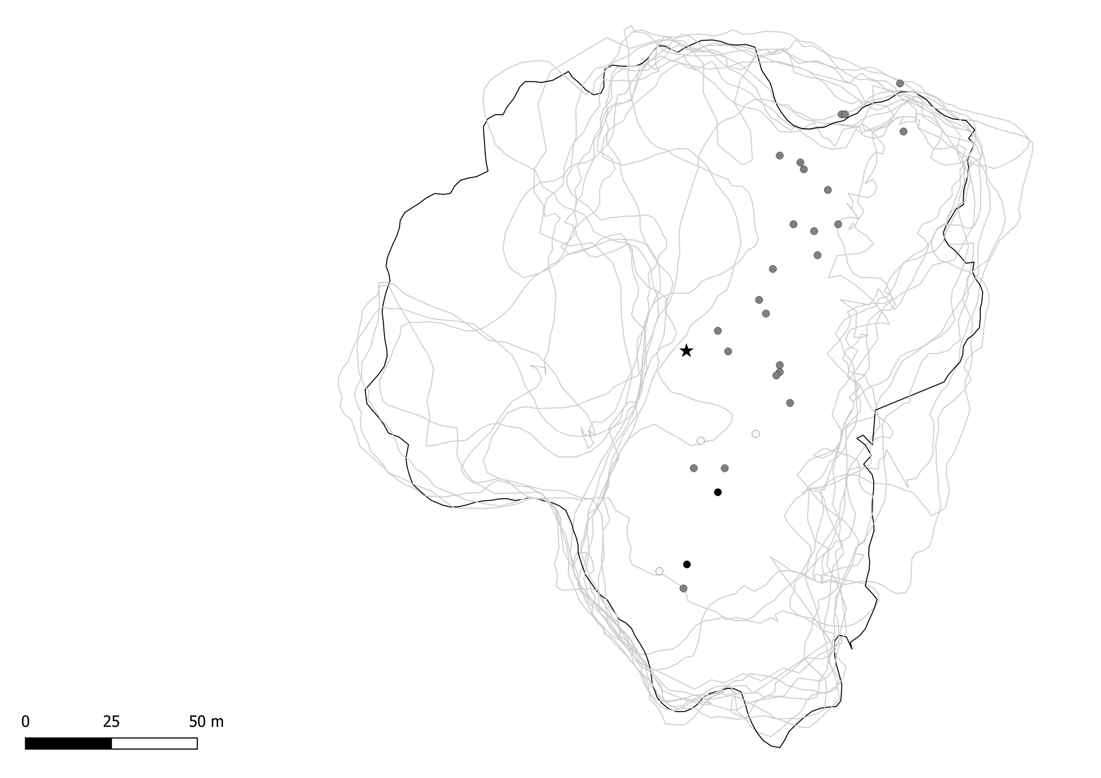
Redcliffe
Male composition
0% Male
Mixed
100% Male
Roost perimeter
August 2018
September 2018
October 2018
November 2018
December 2018
January 2019
February 2019
March 2019
April 2019
May 2019
June 2019
July 2019
August 2019

Slide 9
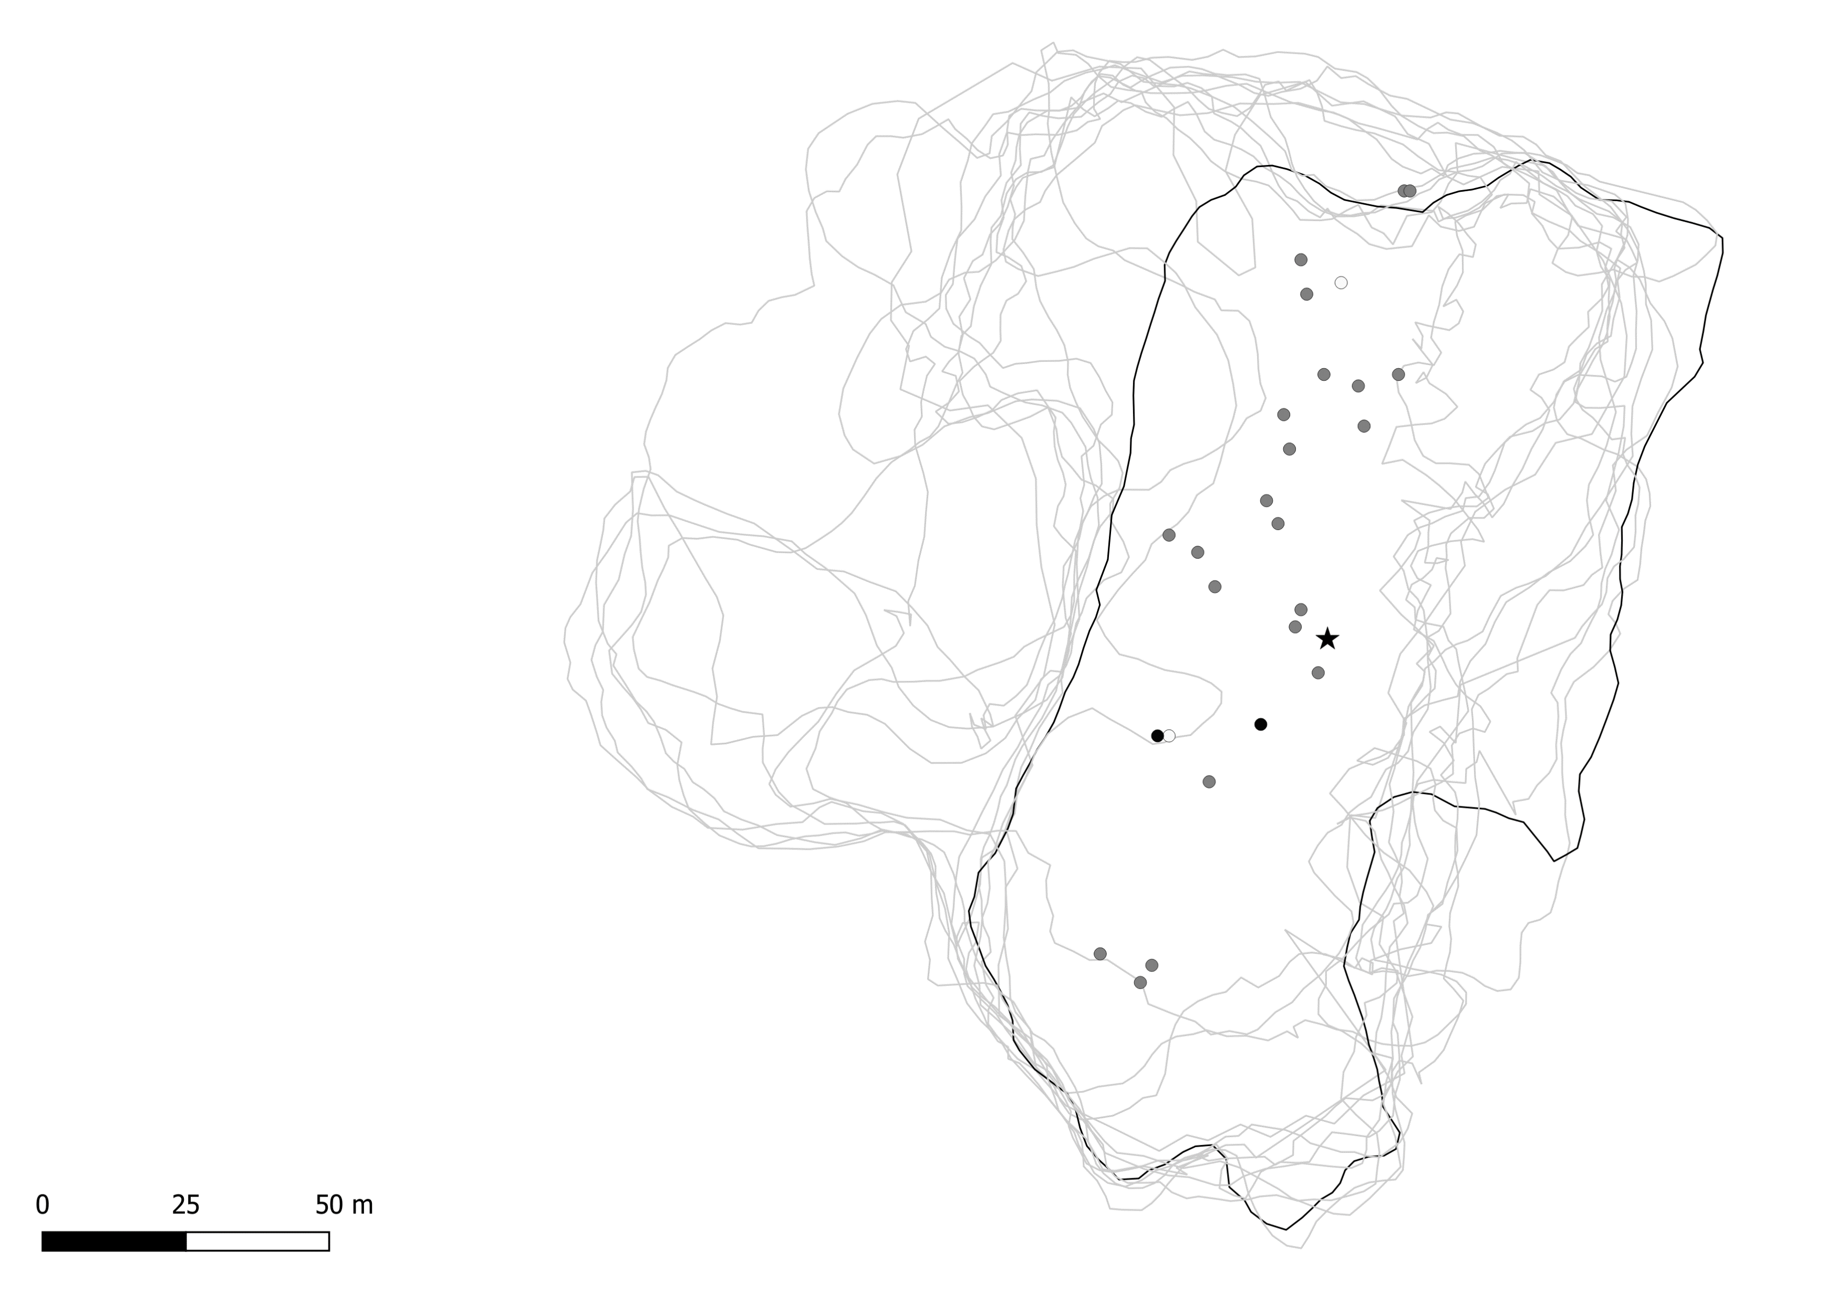
Redcliffe
Male composition
0% Male
Mixed
100% Male
Roost perimeter
August 2018
September 2018
October 2018
November 2018
December 2018
January 2019
February 2019
March 2019
April 2019
May 2019
June 2019
July 2019
August 2019

Slide 10
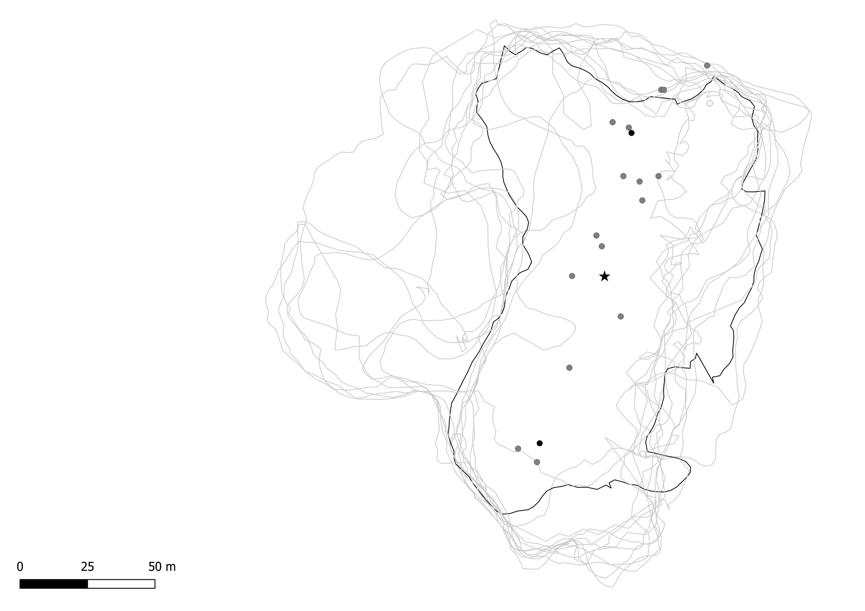
Redcliffe
Male composition
0% Male
Mixed
100% Male
Roost perimeter
August 2018
September 2018
October 2018
November 2018
December 2018
January 2019
February 2019
March 2019
April 2019
May 2019
June 2019
July 2019
August 2019

Slide 11
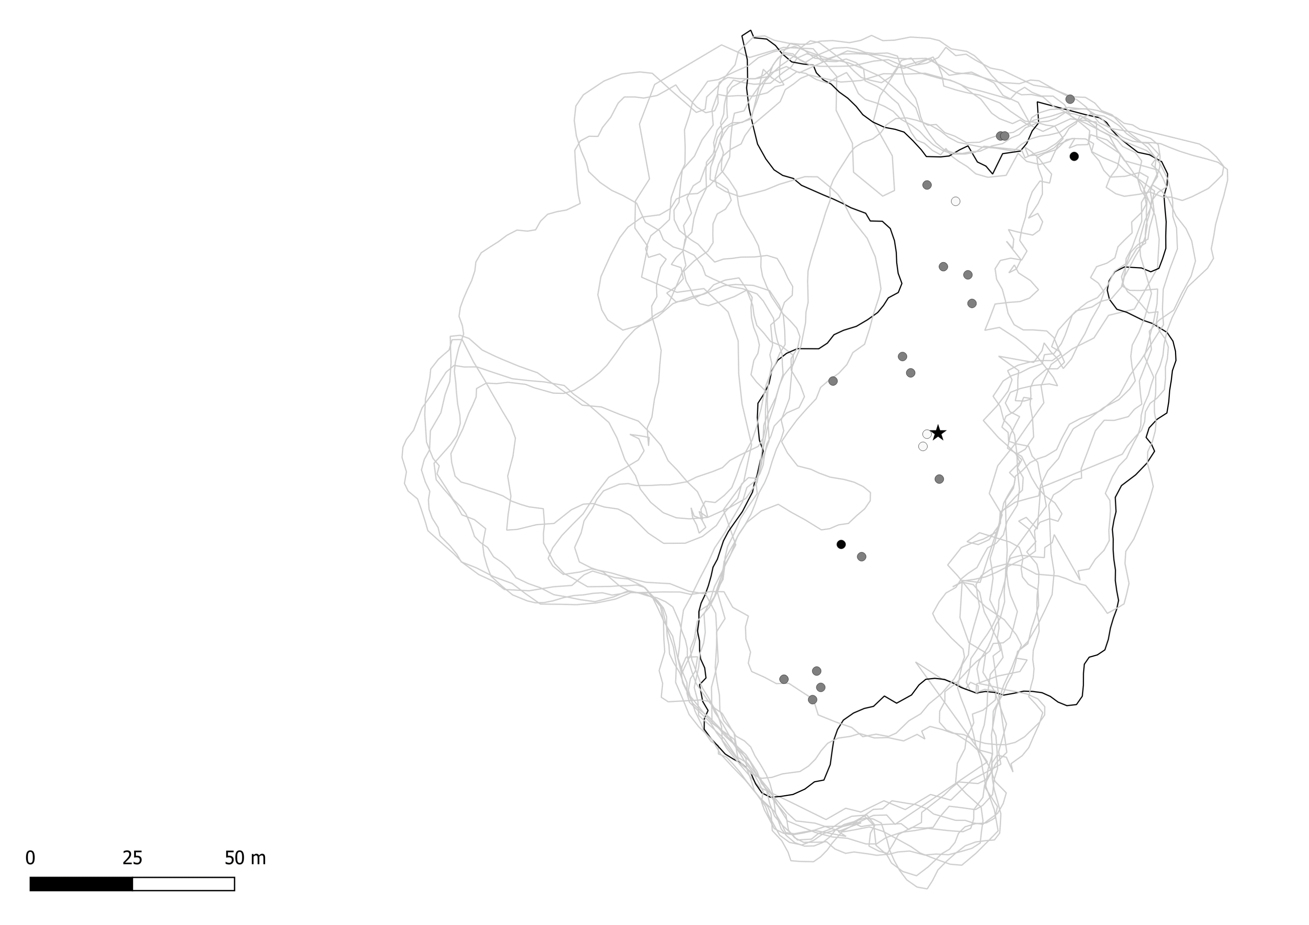
Redcliffe
Male composition
0% Male
Mixed
100% Male
Roost perimeter
August 2018
September 2018
October 2018
November 2018
December 2018
January 2019
February 2019
March 2019
April 2019
May 2019
June 2019
July 2019
August 2019

Slide 12
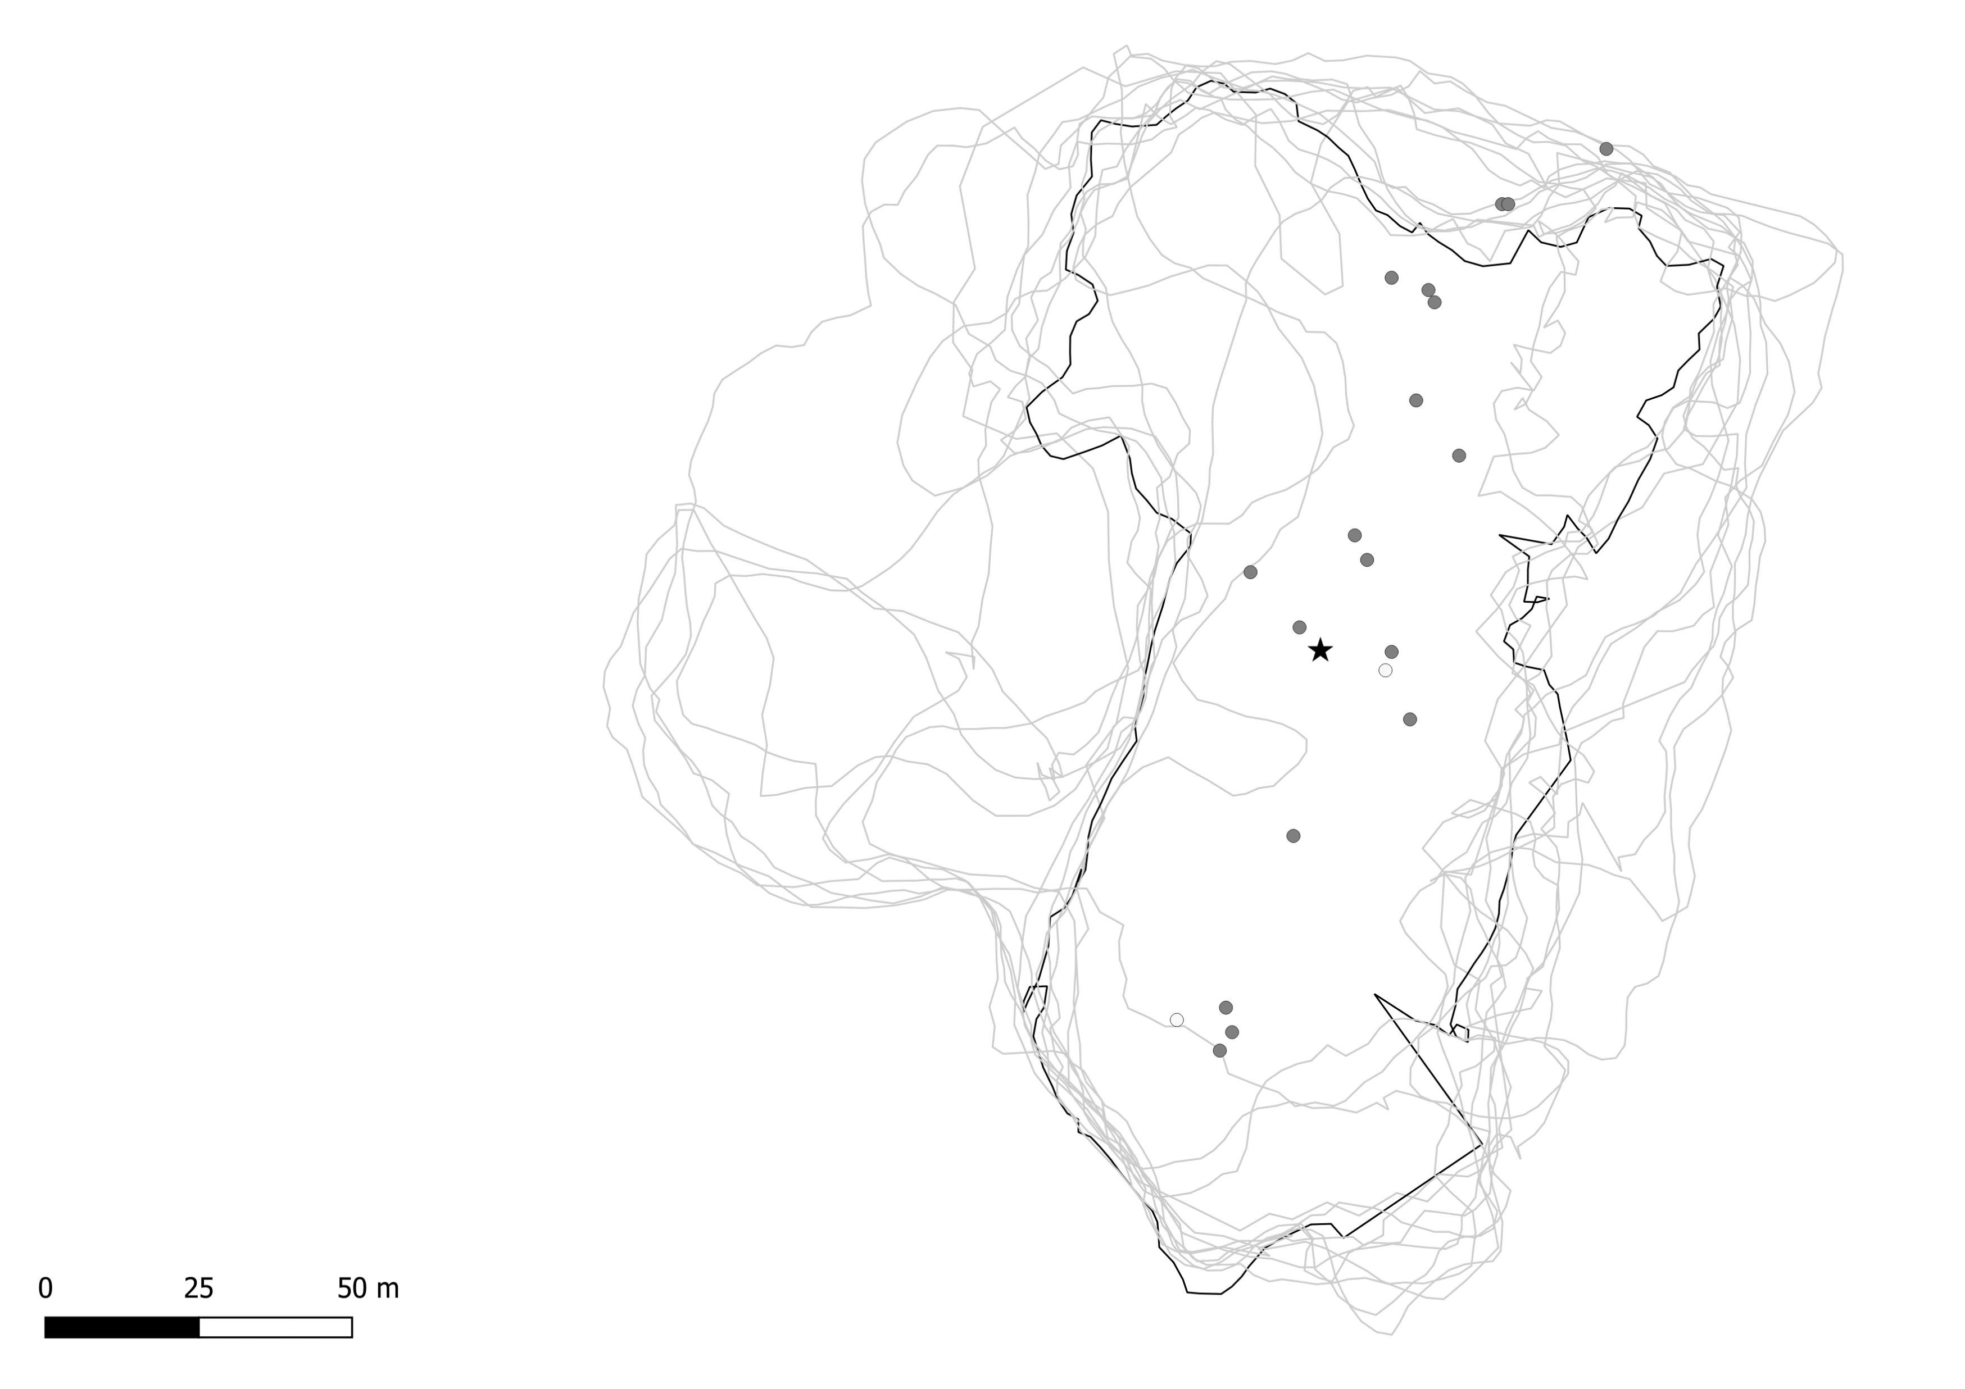
Redcliffe
Male composition
0% Male
Mixed
100% Male
Roost perimeter
August 2018
September 2018
October 2018
November 2018
December 2018
January 2019
February 2019
March 2019
April 2019
May 2019
June 2019
July 2019
August 2019

Slide 13

Redcliffe
Male composition
0% Male
Mixed
100% Male
Roost perimeter
August 2018
September 2018
October 2018
November 2018
December 2018
January 2019
February 2019
March 2019
April 2019
May 2019
June 2019
July 2019
August 2019

